Slide 1
Pragmatics

Slide 2
Pragmatics may mean … “ The study of the speaker’s meaning “

Slide 3
"Pragmatics focuses on what is not explicitly stated and on how we interpret utterances in situational contexts. It is concerned not so much with the sense of what is said , that is, with what is communicated by the manner and style of an utterance."

Slide 4
Invisible Meaning

Slide 5
The way we recognize or understand what is meant even it isn’t actually said or written

Slide 6
Nancy: John , it’s the telephone. John : I’m in the bath . Nancy : ok .

Slide 8
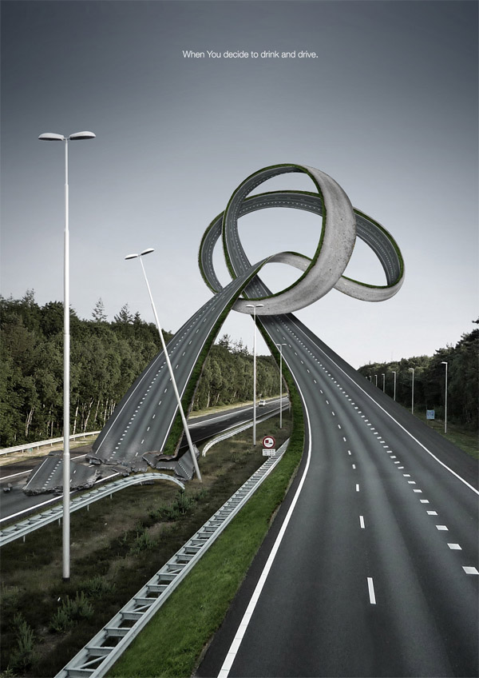

Slide 9
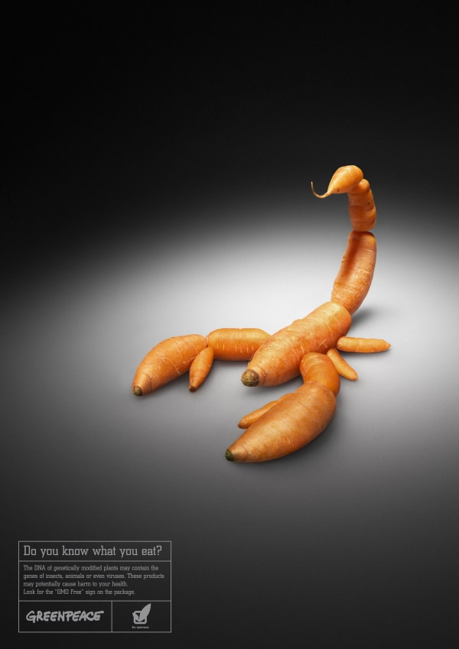

Slide 10
Context

Slide 11
Linguistic context ( co-text): The set of other words used in the same phrase or sentence. The surrounding co-text has strong effect on what we think the word probably means .

Slide 12
The word “ bank “ - The river bank was soapy and steep. - She has to go to the bank to withdraw some cash.

Slide 13
Physical context The physical location influences our interpretation (the time and place in which we encounter linguistic expressions ).

Slide 14
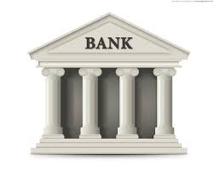

Slide 15
That bank is rocky

Slide 16
Deixis

Slide 17
refers to words and phrases that cannot be fully understood without additional contextual information. Words are deictic if their semantic meaning is fixed but their denotational meaning varies depending on time and/or place.

Slide 18
Some very common words in our language that can’t be interpreted if we don’t know the physical context of the speaker

Slide 19
Deixis expressions can be : 1. person deixis she, him , them , those , .. 2. spatial deixis here , there , near that , .. 3. temporal deixis now , then , last week , ..

Slide 20
Have a look at sentences : Do it now . I enjoy living in this city. Here is where we will place the statue. She was sitting over there.

Slide 21
Reference

Slide 22
An act by which a speaker uses language to enable a listener to identify something . We can use proper , common nouns or pronouns .such as the use of cat , man,…etc.

Slide 23
Anaphora

Slide 24
"The man was holding the cat while the woman poured water on it." The word cat in the antecedent. The word “it” is anaphoric reference. Anaphora means referring back.

Slide 25
“I turned the corner and almost stepped on it. There was a large snake in the middle of the path.” The word “it”, is more explained about the snake ( cataphoric ).

Slide 26
Inference

Slide 27
A successful act of reference depends more on the listener’s ability to recognize what we mean than on the listener’s knowledge of a word use.

Slide 28
An inference is additional information used by the listener to create a connection between what is said and what must be meant .

Slide 29
Examples : - Sally arrives at home at 4:30 and knows that her mother does not get off of work until 5. Sally also sees that the lights are off in their house. Sally can infer that her mother is not yet home.

Slide 30
- A child tries a new fruit and makes a disgusted face. His mother can infer that he does not like the taste of the fruit. - When the phone rang and Liz picked it up, she was all smiles. It can be inferred that she was pleased to receive the phone call.

Slide 31
Presupposition

Slide 32
We design our linguistic messages on the basis of assumptions about what our listeners already know . So, what a speaker assumes is true or known by a listener.

Slide 33
It is an implicit assumption about the world or background belief relating to an utterance whose truth is taken for granted

Slide 34
- Jane no longer writes fiction. Presupposition: Jane once wrote fiction. - Have you stopped eating meat? Presupposition: you had once eaten meat. - My car is a wreck. Presupposition: I have a car.

Slide 35
Speech acts

Slide 36
They are actions such as ‘ requesting , commanding , questioning or informing ‘. So , language users perform actions by utterances.

Slide 37
Language users usually use certain syntactic structure to do certain functions as: Interrogative Question Imperative Command(request) Declarative Statement

Slide 38
When the syntactic structure(content) is identical with the function , the speech act is direct ,as in: - What’s your name ? - Give me that book . - I have a pen . - Let me go .

Slide 39
When the syntactic structure is not identical (a question can be a request), the speech act is indirect, as in : - Can you pass the salt ? - Do you know the way to the garage? - You could be a little more quiet. - Why not stop here.

Slide 40
Indirect speech acts are used because they are more gentle and more polite in our society than direct speech acts. Compare : - Could you open that door for me ? - Open that door .

Slide 41
Politeness

Slide 42
Politeness is best expressed as the practical application of good manners or etiquette. It has to do with ideas as being tactful , modest and nice .

Slide 43
Face Self-image

Slide 44
Negative face refers to the want of every competent adult member that his actions be unimpeded by others Positive face refers to the want of every member that his wants be desirable to at least some others

Slide 45
Face Threatening
Those acts that by their nature run contrary to the face wants of the addressee and/or of the speaker`s
The negative face is threatened by...
…acts that appear to impede the addressee´s independence of movement and freedom of action
The positive face is threatened by…
…acts which appear as disapproving of their wants

